Slide 1
2017 Food for Changed Thought Series
Photovoice: Using Photos and Stories to Create Community Change
The University of Texas at El Paso
January 25, 2017

Slide 2
Thank you for being here today!
Introductions
Lucia Dura, Ph.D.
UTEP, Department of English, Rhetoric and Writing Studies
Antonio Martinez
UTEP Latino Alcohol and Health Disparities Research Center
Eva Moya, Ph.D., LMSW
UTEP College of Health Sciences, Department of Social Work
Lauren Perez, M.A.
UTEP Positive Deviance (PD) Ambassador
Vanessa Sandoval
UTEP M.A. Student in Communication
Maria Torres, Ph.D.
UTEP Alumna Interdisciplinary Health Sciences

Slide 3
Objective:
By the end of the session, you will be able to:
Describe the goals of Photovoice
Explain the methodology
Explore the use of Voices and Images to create community change
In summary, Voices and Images is about:
SHARING PICTURES,
TELLING STORIES,
EMPOWERING PEOPLE,
AND CHANGING COMMUNITIES

Slide 4
Think and Share
Give a name or title to the photograph
Describe what you See
Describe what might be Happening
How does the photograph relate to Our life
Why might that situation exist
What can we Do about it.

Slide 5
PHOTOVOICE GLOSSARY OF TERMS

Slide 6
Photovoice Defined
Photovoice is a Participatory Action Research method that employs photography and group dialogue as a means for marginalized individuals to deepen their understanding of a community issue or concern.
Involves community members taking pictures of their own realities followed by small group consciousness-raising discussions and presentations to decision makers.
Initially developed by Drs. Caroline Wang & Mary A. Burris in 1994 in China.

Slide 7
Photovoice Foundations
Images trigger community self-reflection and discussion to examine root causes of community conditions.
Participatory approach recognizes and honors community members’ subjective experience as researchers, advocates, and participants.
Photographs and stories have been used for decades as a mechanism for social reform.

Slide 8
Photovoice: Underpinnings
Education for critical consciousness
  Participants consider and seek to act upon the historical, institutional, social, and political conditions that contribute to personal and community problems (Freire, 1974; Minkler & Wallerstein, 2014)
Feminist theory
  Everyone has a specific story, a particular experience of the configuration of class, race, gender, sexuality, family, country, displacement, alliance…. Those stories are mediated by the forms of representation available in the culture (Wang, 1999; 2004)
  Documentary photography
Notes:
8

Slide 9
Examples of Photovoice Projects
Language of Light Project. Homeless women and men living in a shelter in Ann Arbor, MI (Wang, Cash, & Powers, 2000).
The Voices of Students at Risk: A social validity study of Photovoice with at-risk students in Midwestern city (Kroeger, 2003).
Giving local health departments a new perspective on community health issues, Contra Costa, CA (Spears, 1996; Pies & Parthasarathy, 2005).

Slide 10
Photovoice is designed to enable people to:
Produce and discuss photographs as a means of catalyzing personal and community change.
Document persons reality of their lives.
Use the power of visual images to communicate their experiences and perceptions.
Through critical reflection, discuss individual change, community quality of life and policy issues (Wallerstein, 1987).
Creates evidence and promotes vivid participatory means of sharing experiences and knowledge through the immediacy of the visual image.

Slide 11
Participatory Action Research (PAR)
A method of collaborative research that involves increased understanding of an issue of concern and efforts aimed at improving social conditions through individual and group action.
Photovoice is a form of PAR

Slide 12
Method
Photovoice
Research
Practice & Action
Data collection
Data analysis
Report writing
Galleries
CBR project design
Resource development
Assessment tool
Need identification
Asset mapping
Empowerment
Political commitment
Making changes
Participatory Action Research (PAR)

Slide 13
Photovoice Facilitator
An individual that has a range of skills necessary to facilitate the form of PAR.
Requires knowledge of the research process, ethical guidelines and method.
Assumes the role of co-researcher and works closely with community members.

Slide 14
Photovoice Participant
A community member representing a marginalized group who agrees to take part. Fulfills several roles in order to achieve the goals of the project.
Persons affected by social condition who take photos and describe through stories in small group meetings!

Slide 15
Roles of Participants
Link with the community
Gain trust with co-researchers
Take, selection and sort photographs
Explain stories in the meetings
Participate in data collection
Helps reduce barriers
Participate in community meetings, photo exhibition
Advocates for change with policy and decision makers

Slide 16
Advisory Committee
Members of a group who are selected to hear the message about the issue of concern conveyed through Photovoice. Members are selected based on their ability or power to influence decisions and policies and to make changes that can improve the lives of community members.
Probably these are educators, activists, scholars social workers, health workers, researchers, members of the media, local leaders!

Slide 17
Marginalized Groups
Groups of individuals who are most excluded from public discussion and who have limited access to centers of influence and power. Able to have their voices heard and bring forth ideas to influence the decisions and policies that affect their lives.
People with disability, health conditions, vulnerable groups, not getting access (limited or inadequate) to services!

Slide 18
Decision Makers
Members of the community who have the ability or power to influence and make decisions on behalf of others. Includes policy-makers, those who determine public guidelines and policy.
The audience in Photovoice includes decision and policy makers!

Slide 19
Co-Researcher
A member of a group who shares responsibility for planning and carrying out a research project. In Photovoice, community members are co-researchers along with facilitator. Together, they make decisions about the focus of the project, collect and analyze data, create new knowledge and share findings with others.
Community members along with facilitator!

Slide 20
Data
Information gained through the research process. Photographs, taken by community members, and their stories describing and explaining the photographs, are the main data collected.
Photographs with explanations!

Slide 21
Data Collection
The process of gathering information through a variety of activities and events. Taking photographs, participating in group meetings, recording discussions, guided dialogue, exhibition feedback and debriefing. Data collection is ongoing because information is gained right from the beginning until the end.
Capturing the photos and recording dialogues!

Slide 22
Coding
Identifying and sorting data into categories of meaningful issues, themes or theories. Takes place through group discussions where participants share photographs and discuss common themes and issues.
Participants show photographs and tell the themes and issues!

Slide 23
Contextualizing
Understanding or explaining how something fits within a larger set of circumstances. As participants engage in dialogue with other participants they can voice their individual and group experiences.
For example, a photo of a sub-standard apartment can lead to a discussion of a larger context which includes the lack of affordable housing, low wages, social service shelter allowance policies and power relationships between tenants and landlords.
Problem identification and or meaningful issues and themes!

Slide 24
Data Analysis
The process of carefully exploring, examining and comparing the data collected. Through data analysis we develop a better understanding of the issue of concern being addressed.
By analyzing the data, co-researchers can determine general themes and patterns, and identify how individual issues relate to the experiences of others.
How individual issues relate to others!

Slide 25
Ethical Guidelines
All research is governed by strict ethical considerations and guidelines. Researchers are expected to do no harm through research activities. The ethical principles ensure that participants and other individuals or groups are not harmed as a result of activities.

Slide 26
Informed Consent
Agreement to do something or allow something based on having all the facts and being educated on risks and benefits.
Participants must be educated about the complete process, the multiple roles and responsibilities and the advantages and the possible risks of participation.
Only then, once fully aware can community members agree to participate.

Slide 27
Key Concepts
  Images teach
  Pictures can Influence policy
  Community members ought to participate in shaping public policy
  Influential policy-makers must be the audience to the perspectives of community members
  Photovoice emphasizes individual and community action
  (Wang, 1999; Wang & Pies, 2004; Moya, Chavez-Baray, & Martinez, 2014).

Slide 28
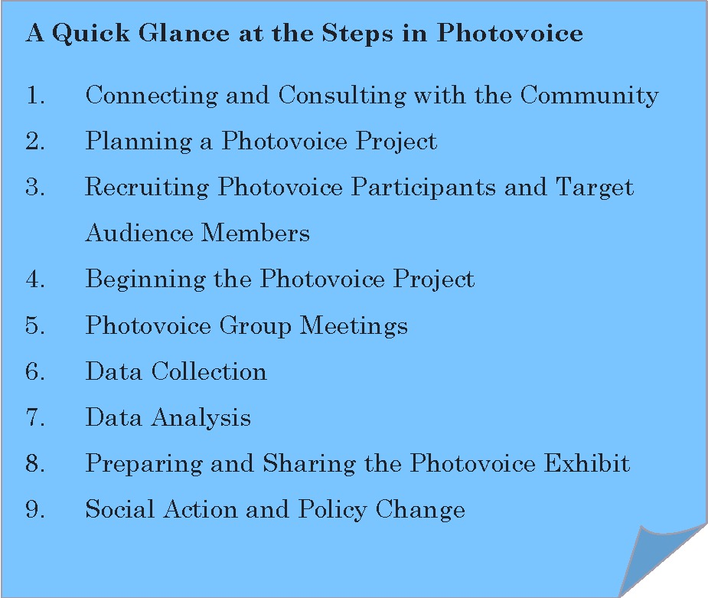
STEPS IN THE PHOTOVOICE METHOD

Slide 29
Framing the First Questions
Who are the people that make up our community?
What are the natural and human-made features of our community?
What social systems make up our community?

Slide 30
Describing the Story
What do you See here?
Pretend someone can’t see the picture
What is really Happening?
Actions and feelings in the picture
How does this relate to Our lives?
Your feelings and how your experiences are similar or different
Why does this situation, concern, or strength Exist?
Underlying meaning and impacts on you and community
What can we Do about it?
Actions to be taken to solve problems or build upon strengths
Develop by Nina Wallerstein and Edward Bernstein and adapted for use in Photovoice by Caroline Wang and Mary Ann Burris. Translated to Spanish by Eva Moya (2008)

Slide 31
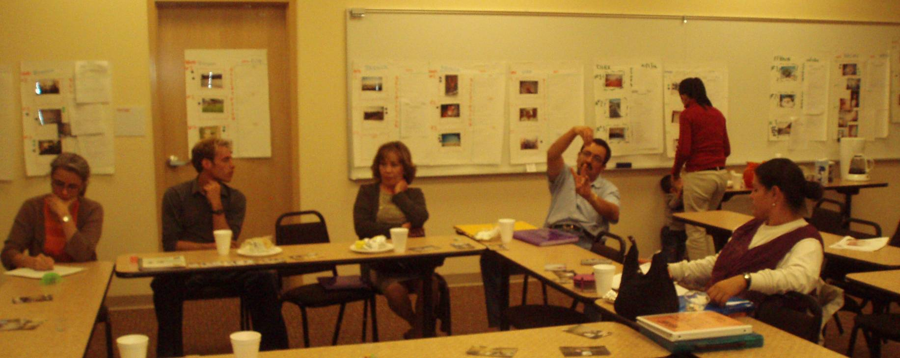
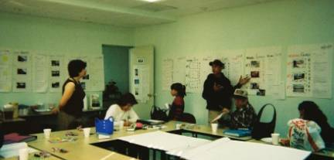
Sharing Photos and Stories
Photos courtesy of E. Moya

Slide 32
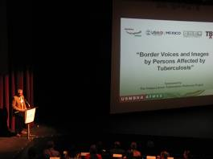
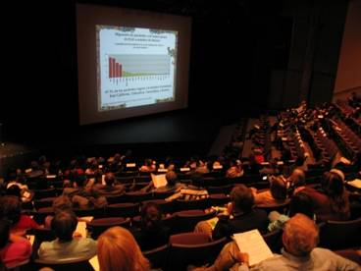
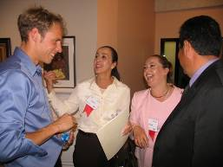
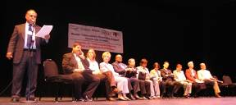
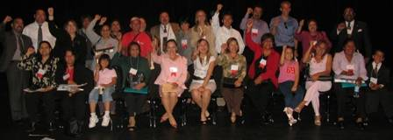
Presentación Comunitaria
Imágenes por Voces e Imágenes de la TB

Slide 33
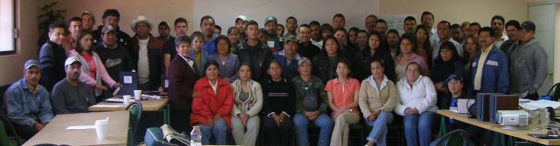
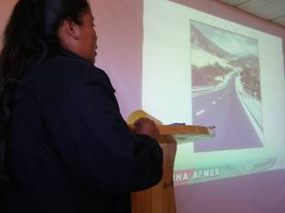
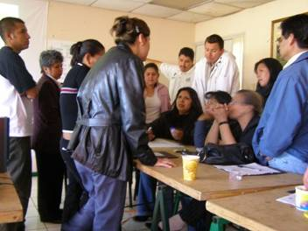
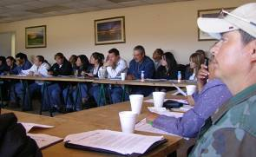
Photovoice Methodology Training (Guachochi, CHIH)
Photographs courtesy of O. Vasquez

Slide 34
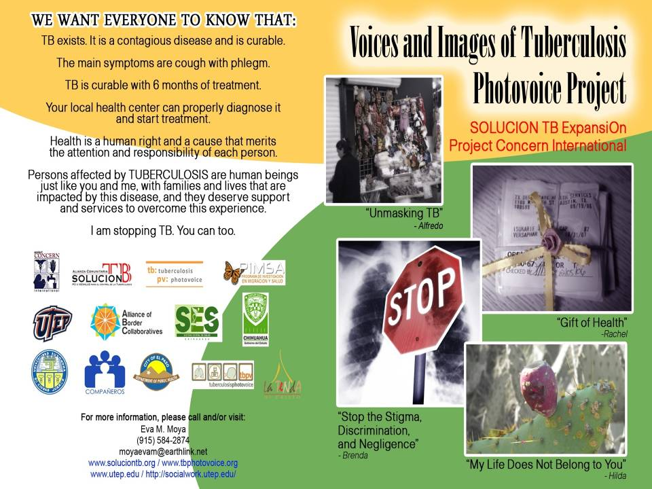

Slide 35
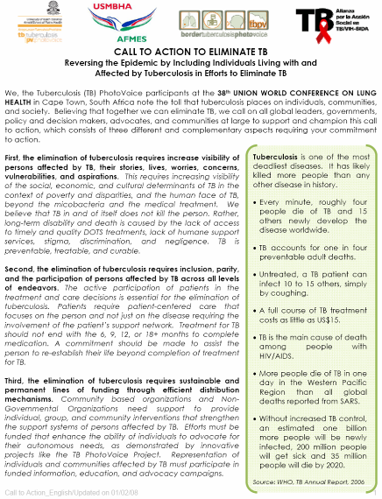
Call to Action to Eliminate TB
-Created by Photovoice Participants in South Africa

Slide 36
To download a copy of the Voices and Images articles, please visit www.casesjournal.org/volume2

Slide 37
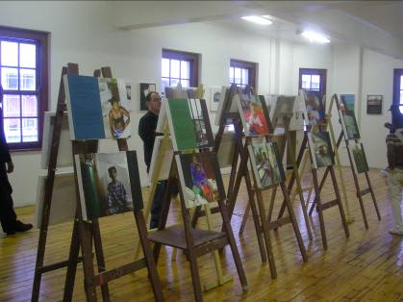
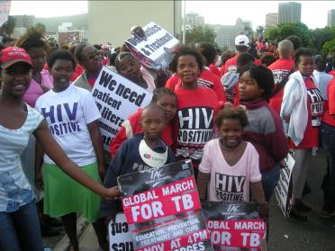
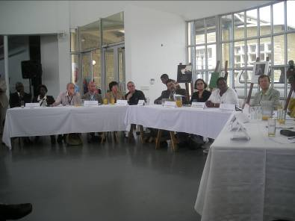
International Presentations
Imágenes por Fotovoz TB Amaya-Lacson

Slide 38
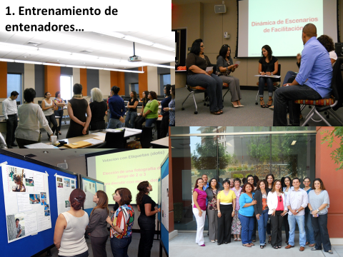
Train theTrainer

Slide 39
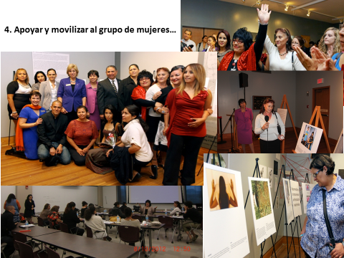

Slide 40
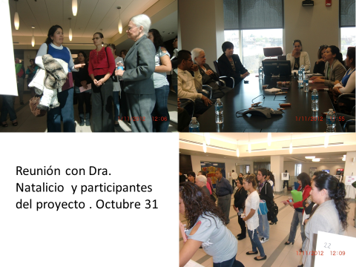

Slide 41
If you are thinking about Photovoice, here are some things to ponder:
Are you genuinely interested in community-based collaborative research?
Have you done background reading or learned enough about method to feel comfortable with use?
Have you secured funding for project?
Are you prepared to seek funding by writing proposals or connecting with agencies?
Do you have, or are you willing to develop, strong connections with the community?
Is there an issue in your community that you are deeply concerned about?
Do you have ideas about possible solutions or policy improvements related to that concerning issue?

Slide 42
Speed Networking: Take home message
How could you use Photovoice method for community change?
With students?
For policy?
Other….
.

Slide 43
Thank you
http://www.homelessopportunitycenter.org/
Welcome your questions, comments, suggestions
emmoya@utep.edu

